Slide 1
Adaptive Influence Balancing for Multi-Agent LLM Debates
Extending Process-Based Diagnostics into Debate Control
Kyle Lin - Summer Research Proposal – 2026
Advisor: Prof. Feng Chen
Mentor: Tianhao Wang

Slide 2
Motivation
Multi-agent debate is becoming a core AI paradigm
Applications: reasoning, planning, code generation, governance
Question:
Does more discussion always lead to better answers?
How do we prevent potentially correct reasoning trajectories from being eliminated before they are fully explored?
Can adaptive influence balancing improve debate quality?
Can minority viewpoints be preserved long enough to improve final decisions?
Can process interventions improve reliability and calibration?

Slide 3
ICML 2026 Paper: Key Insight
Consensus is not enough
Process metrics framework: Engagement, Responsiveness, Balance, Influence Asymmetry
Consensus ≠ Correctness

Slide 4
Research Gap
Existing work measures debate quality
My extension: Observe → Measure → Control → Improve
Can diagnostics (process metrics) become feedback signals?
Try: 1. Adaptive influence re-balancing; 2. Reasoning diversity preservation

Slide 5
Hypothesis
Debate failures occur when influence concentrates too early
Consequences: groupthink, minority suppression, false consensus
Adaptive balancing can improve reliability
Reasoning diversity preservation can prevent potentially correct reasoning trajectories from being eliminated too early

Slide 6
Proposed Framework
Compute process metrics every round
Detect excessive influence asymmetry
Trigger interventions dynamically

Slide 7
Experimental Design

Slide 8
Experiment 1: Baseline
Original paper setup
Fixed debate protocol
No intervention
Reference point for comparison

Slide 9
Experiment 2: Loser-More-Resistance
When an agent consistently loses influence:
Increase loser resistance
Reduce susceptibility to dominant opinions
Prevent premature convergence
Goal: Prevent early domination.

Slide 10
Experiment 3: Minority Protection
For each round, use agents’ influence scores to determine Minority/Dominant agents
dominant_agent = argmax(influence)
minority_agents = influence < threshold
Minority agents receive:
Additional reasoning budget
Extra evidence generation
Additional speaking opportunities
Potential Influence Cap to avoid SUPER agent. Intervention: No single agent can exceed a maximum influence share, to prevent runaway dominance.
Goal: Keep alternative hypotheses alive longer

Slide 11
Experiment 4: Devil's Advocate
Dominant agents must challenge their own position
Majority agent must argue against itself
Generate counterarguments to encourage exploration of alternatives
If diversity drops below threshold: Automatically introduce: "Generate an alternative explanation.“ or "Identify a hidden assumption.“
Resurrection Protocol: Retrieve discarded arguments to break dominance
Prompt: "Select one previously rejected argument and re-evaluate it."
Example:
Round 1: Argument B rejected
Round 5: Argument B revisited
Goal: Stress-test dominant reasoning, reduce overconfidence and groupthink. Recover exploration when debate becomes too homogeneous.

Slide 12
Experiment 5: Uncertainty-Aware Debate
Agents report Answer Confidence Reasoning
If: High Confidence + Strong Consensus, No intervention.
If: Low Confidence + Strong Consensus, Trigger debate extension!
Debate extension would include all interventions noted in Experiment #2, 3 & 4
Motivation: False consensus often emerges when nobody is truly confident.

Slide 13
Research Framework
Research Story : “Adaptive Influence Balancing & Reasoning Diversity Preservation in Multi-Agent LLM Debates “
Central hypothesis: Debate failures occur because influence concentrates too early and potentially correct reasoning trajectories are eliminated before sufficient exploration occurs.
Interventions:
Category | Method
Influence Control | Loser-More-Resistance, Influence Cap
Diversity Preservation | Minority Protection
Diversity Preservation | Diversity Trigger
Hypothesis Preservation | Resurrection Protocol
Robustness Testing | Devil's Advocate

Slide 14
Evaluation Plan

Slide 15
Evaluation Plan – part 1
Evaluation Level 1: Accuracy
Accuracy
Measure: # of correct answers / total # of questions
Question: Do the debate interventions we introduce improve the overall quality of the debate?
Example
Baseline
# of final answer is correct = 40
# of total questions = 50 Accuracy = 80%
I hope that at least one of the interventions we introduce will improve accuracy.

Slide 16
Evaluation Plan – part 2
Evaluation Level 2: Consensus Reliability This is where we make the difference
Consensus Reliability
Measure: Prob(correct | consensus)
Question: When agents agree, how often are they actually right?
Example
Baseline
Consensus reached = 90% Correct = 70%
Reliability: 0.70 / 0.90 = 78%
We expect the improved adaptive protocol should increase this.

Slide 17
Evaluation Plan – part 3
Evaluation Level 3: Early-Elimination analysis (I want to directly test my hypothesis)
For every debate each round, Identify: Correct Hypothesis
When was it first proposed?
When was it abandoned?
Did it later become the final answer?
New metric: Premature Elimination Rate (PER)
Definition:
Correct hypotheses discarded before final rounds/ All correct hypotheses proposed
Example: 100 debates, Correct answer proposed early:
70 times
Discarded early:
28 times
PER: 28 / 70 = 40%

Slide 18
Final Evaluation Study
Question: Which intervention contributes most?
Setting | Consensus Reliability | PER | Accuracy
Baseline
Penalty-to-Loser
Minority Protection
Delayed Consensus
Devil's Advocate
Resurrection
Full System
Rather than measuring only final accuracy, I also want to measure whether the debate preserves and eventually recovers correct reasoning trajectories that would otherwise be eliminated too early.

Slide 19
Important figure to include
Correct Hypothesis Survival Probability 1.0 |\ | \ 0.8 | \ | \ Adaptive 0.6 | \____ | 0.4 |________ Baseline | 0.2 | +------------------ Debate Round
Interpretation:
Under baseline debates, correct reasoning paths disappear quickly.
Under adaptive influence balancing system, correct reasoning survives longer and is more likely to become the final answer.
This figure would directly support our central claim

Slide 20
Expected Contributions
Adaptive control of debates
Influence balancing for reliability
Process-aware uncertainty estimation
Higher final-answer reliability

Slide 21
Why This Matters for Reliability Research
Most work studies model confidence
This project studies social uncertainty
Reliable collective intelligence requires healthy deliberation dynamics

Slide 22
Experiment #2

Slide 23
Experiment 2a: Loser-More-Resistance - Methodology
Use the exact same 200 questions from baseline case, not a fresh MMLU-Pro sample.
Keep the baseline protocol identical: 3 agents, 5 rounds, same model, same seed, same temperature/top-p, same final-answer moderator fallback.
Add agent-resistance state:
resistance[agent] starts at 0.0
alpha = 0.08; resistance_cap = 0.65; W = 2
loser threshold = influence/support < 1.5
4. For MMLU multiple-choice questions, adapt “influence” categorically:
support(agent, round) = number of agents currently giving the same answer
trend = support_t - support_(t-1)
loser = support_t < 1.5 and trend < 0
With 3 agents, this means an agent is basically isolated and becoming less supported.
5. When an agent is flagged as a loser: resistance[a] = min(resistance[a] + 0.08, 0.65)

Slide 24
Experiment 2a: Loser-More-Resistance - Methodology
5. New prompt for loser: “Your current resistance level is 0.32. You appear to be losing peer support, but do not switch merely because other agents agree. Re-evaluate your own answer from first principles. Change only if the other agents provide specific evidence that defeats your reasoning. If your original answer remains defensible, preserve it and explain why. “
For unflagged agents, use the current prompt unchanged.
6. Log the intervention state. Logges columns:
row_index
question_no
round
agent
answer
support
support_trend
loser_flag
resistance_before
resistance_after
intervention_applied

Slide 25
Experiment 2b: Loser-More-Resistance – Methodology – Use diagnostics as adaptive trigger
Use the exact same 200 questions from baseline case, not a fresh MMLU-Pro sample.
Keep the baseline protocol identical: 3 agents, 5 rounds, same model, same seed, same temperature/top-p, same final-answer moderator fallback.
Add agent-resistance state:
resistance[agent] starts at 0.0
alpha = 0.08; resistance_cap = 0.65; W = 2
4. For MMLU multiple-choice questions, compute live categorical diagnostics from completed rounds: engagement = confidence-weighted answer change responsiveness = confidence-weighted change toward better-supported answers influence_asymmetry = concentration of who other agents are copying balance = whether convergence is gradual/stable rather than sudden collapse
5. Flag an agent for resistance when live metrics suggest over-convergence: agent changes to a dominant prior answer under high influence asymmetry, or agent changes to the current majority answer when balance is low / convergence is too rapid

Slide 26
Experiment 2b: Loser-More-Resistance - Methodology
6. When an agent is metric-triggered: resistance[a] = min(resistance[a] + 0.08, 0.65)
7. New prompt for triggered resistance: “Your current resistance level is 0.32. Because the live diagnostics indicate high influence asymmetry or low balance / rapid convergence, do not switch merely because other agents agree. Re-check your own answer from first principles, identify the strongest evidence for and against it, and change only if a specific peer argument defeats your reasoning. If your prior answer remains defensible, preserve it and explain why.”
For untriggered agents, use the current prompt unchanged except for reporting the resistance score.
8. Log the intervention state. Logged columns include:

Slide 27
Experiment 2: Loser-More-Resistance - Results
Experiment ID | Baseline | Experiment #2 | Experiment #2b
stance_mode | categorical | categorical | categorical
Total Questions | 200 | 200 | 200
accuracy_count | 109 | 111 | 116
accuracy_mean | 0.545 | 0.555 | 0.58
accuracy_std | 0.4992205 | 0.498212887 | 0.49479705
engagement_mean | 0.10552083 | 0.092020833 | 0.104979167
engagement_std | 0.186492 | 0.16371751 | 0.181605752
responsiveness_mean | 0.045 | 0.035666667 | 0.045875
responsiveness_std | 0.08160263 | 0.070869214 | 0.086812818
influence_asymmetry_mean | 0.09788024 | 0.13260278 | 0.119810421
influence_asymmetry_std | 0.22088939 | 0.269119577 | 0.26371225
influence_asymmetry_inv_count | 200 | 200 | 200
influence_asymmetry_inv_mean | 0.90211976 | 0.86739722 | 0.880189579
influence_asymmetry_inv_std | 0.22088939 | 0.269119577 | 0.26371225
balance_count | 200 | 200 | 200
balance_mean | 0.6921031 | 0.6571031 | 0.695515496
balance_std | 0.46145706 | 0.474580081 | 0.454658987
stability_mean | 0.97333333 | 0.983333333 | 0.978333333
stability_std | 0.090658 | 0.07283062 | 0.082381499
group_welfare_mean | 0.14666667 | 0.166666667 | 0.173333333
group_welfare_std | 0.3483069 | 0.318777677 | 0.348819498
avg_process_metrics_count | 200 | 200 | 200
avg_process_metrics_mean | 0.43618592 | 0.413046955 | 0.43163981
avg_process_metrics_std | 0.14614502 | 0.154337642 | 0.152030371

Slide 28
Experiment 2: Loser-More-Resistance - Results
 | Baseline | Experiment #2 | Experiment #2b
total_questions | 200 | 200 | 200
correct_final_answers | 109 | 111 | 116
accuracy | 0.545 | 0.555 | 0.58
consensus_questions | 184 | 190 | 187
correct_consensus_answers | 105 | 107 | 109
consensus_reliability | 0.570652174 | 0.56315789 | 0.582887700
correct_hypotheses_proposed_before_final | 122 | 122 | 128
correct_hypotheses_discarded_before_final | 10 | 11 | 10
premature_elimination_rate | 0.081967213 | 0.090163934 | 0.078125

Slide 29
Experiment #3

Slide 30
Experiment 3a:
Use the exact same 200 questions from the baseline case, not a fresh MMLU-Pro sample.
Keep the baseline protocol identical: 3 agents, 5 rounds, same model, same seed structure, same temperature/top-p, same final-answer moderator fallback.
Add minority-protection state: minority_support_threshold = 1.5 minority_extra_tokens = 110
For MMLU multiple-choice questions, identify minority status categorically from the previous round:
support(agent, round) = number of agents currently giving the same answer

Slide 31
Experiment 3a:
5. New prompt for loser: “Your previous answer was the lone answer that differed from the other agents’ majority answer. Before updating, give your minority hypothesis a fair test: generate the strongest evidence for it, identify the strongest evidence against it, and change only if a specific peer argument defeats your reasoning. If your answer remains defensible, preserve it and explain why.”
For unflagged agents, use the normal update prompt, with no active minority-protection intervention.
6. Give protected minority agents extra reasoning budget:
max_new_tokens = baseline max_new_tokens + 110
Non-minority agents keep the baseline token budget unchanged.
7. Log the intervention state.

Slide 32
Experiment 3a:
For each debate round after Round 1:
Check agents' previous answers
If two agents agree
and one agent disagrees:
Mark disagreeing agent as minority/loser
Give that agent:
- extra reasoning budget
- instruction to defend its answer
- instruction to switch only if evidence is stronger
Else:
Continue normal debate

Slide 33
Experiment 3b:
For each debate round after Round 1:
Compute live debate diagnostics:
- influence asymmetry
- balance
If influence is too concentrated:
Protect low-influence agents
If debate is converging too quickly:
Protect agents whose views may be collapsing
Protected agents receive:
- extra reasoning budget
- instruction to re-test minority hypotheses
- instruction to switch only if evidence is stronger

Slide 34
Experiment 3:
 | Baseline | Experiment #2a | Experiment #2b | Experiment #3a | Experiment #3b
total_questions | 200 | 200 | 200 | 200 | 200
correct_final_answers | 109 | 111 | 116 | 115 | 120
accuracy | 0.545 | 0.555 | 0.58 | 0.575 | 0.6
consensus_questions | 184 | 190 | 187 | 167 | 180
correct_consensus_answers | 105 | 107 | 109 | 97 | 109
consensus_reliability | 0.570652174 | 0.56315789 | 0.5828877 | 0.580838323 | 0.605555556
correct_hypotheses_proposed_before_final | 122 | 122 | 128 | 129 | 126
correct_hypotheses_discarded_before_final | 10 | 11 | 10 | 8 | 4
premature_elimination_rate | 0.081967213 | 0.090163934 | 0.078125 | 0.062015504 | 0.031746032

Slide 35
Experiment 3:
Experiment ID | Baseline | Experiment #2a | Experiment #2b | Experiment #3a | Experiment #3b
stance_mode | categorical | categorical | categorical | categorical | categorical
Total Questions | 200 | 200 | 200 | 200 | 200
accuracy_count | 109 | 111 | 116 | 115 | 120
accuracy_mean | 0.545 | 0.555 | 0.58 | 0.575 | 0.6
accuracy_std | 0.4992205 | 0.498212887 | 0.49479705 | 0.49558351 | 0.491127305
engagement_mean | 0.10552083 | 0.092020833 | 0.104979167 | 0.076041667 | 0.116166667
engagement_std | 0.186492 | 0.16371751 | 0.181605752 | 0.117143342 | 0.192878859
responsiveness_mean | 0.045 | 0.035666667 | 0.045875 | 0.01075 | 0.047291667
responsiveness_std | 0.08160263 | 0.070869214 | 0.086812818 | 0.042758639 | 0.081418269
influence_asymmetry_mean | 0.09788024 | 0.13260278 | 0.119810421 | 0.234997549 | 0.141524243
influence_asymmetry_std | 0.22088939 | 0.269119577 | 0.26371225 | 0.388212404 | 0.280992046
influence_asymmetry_inv_mean | 0.90211976 | 0.86739722 | 0.880189579 | 0.765002451 | 0.858475757
influence_asymmetry_inv_std | 0.22088939 | 0.269119577 | 0.26371225 | 0.388212404 | 0.280992046
balance_mean | 0.6921031 | 0.6571031 | 0.695515496 | 0.728412397 | 0.66674573
balance_std | 0.46145706 | 0.474580081 | 0.454658987 | 0.440367367 | 0.466151542
stability_mean | 0.97333333 | 0.983333333 | 0.978333333 | 0.941666667 | 0.966666667
stability_std | 0.090658 | 0.07283062 | 0.082381499 | 0.139543405 | 0.100250941
group_welfare_mean | 0.14666667 | 0.166666667 | 0.173333333 | 0.106666667 | 0.151666667
group_welfare_std | 0.3483069 | 0.318777677 | 0.348819498 | 0.325296755 | 0.351748444
avg_process_metrics_mean | 0.43618592 | 0.413046955 | 0.43163981 | 0.395051629 | 0.422169955
avg_process_metrics_std | 0.14614502 | 0.154337642 | 0.152030371 | 0.173904703 | 0.164393221

Slide 36
Appendix

Slide 37
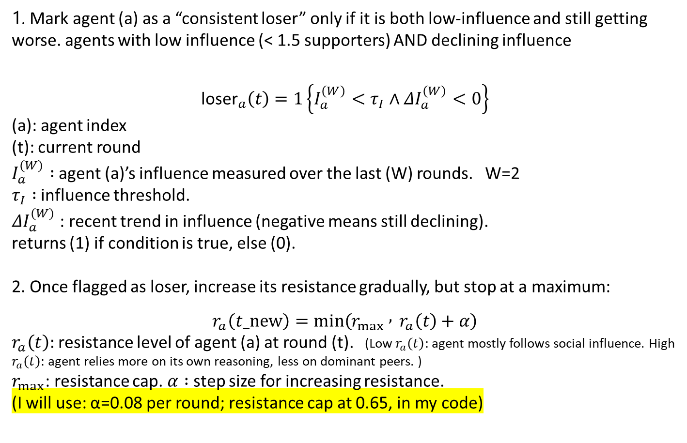
Experiment 2: Loser-More-Resistance - Methodology
1. Mark agent (a) as a “consistent loser” only if it is both low-influence and still getting worse. agents with low influence (< 1.5 supporters) AND declining influence
$${\text{loser}}_{a}\left(t\right)=1\left\{I_{a}^{\left(W\right)}<τ_{I}∧ΔI_{a}^{\left(W\right)}<0\right\}$$
(a): agent index
(t): current round
$I_{a}^{\left(W\right)} :$agent (a)’s influence measured over the last (W) rounds. W=2
$τ_{I} :$influence threshold.
$ΔI_{a}^{\left(W\right)}$: recent trend in influence (negative means still declining).
returns (1) if condition is true, else (0).
2. Once flagged as loser, increase its resistance gradually, but stop at a maximum:
$$r_{a}\left(t_new\right)=min⁡\left(r_{max} , { r}_{a}\left(t\right)+α\right)$$
$r_{a}\left(t\right):$resistance level of agent (a) at round (t). (Low $r_{a}\left(t\right):$agent mostly follows social influence. High $r_{a}\left(t\right):$agent relies more on its own reasoning, less on dominant peers. )
$r_{max}$: resistance cap. $α :$step size for increasing resistance.
(I will use: α=0.08 per round; resistance cap at 0.65, in my code)

Slide 38
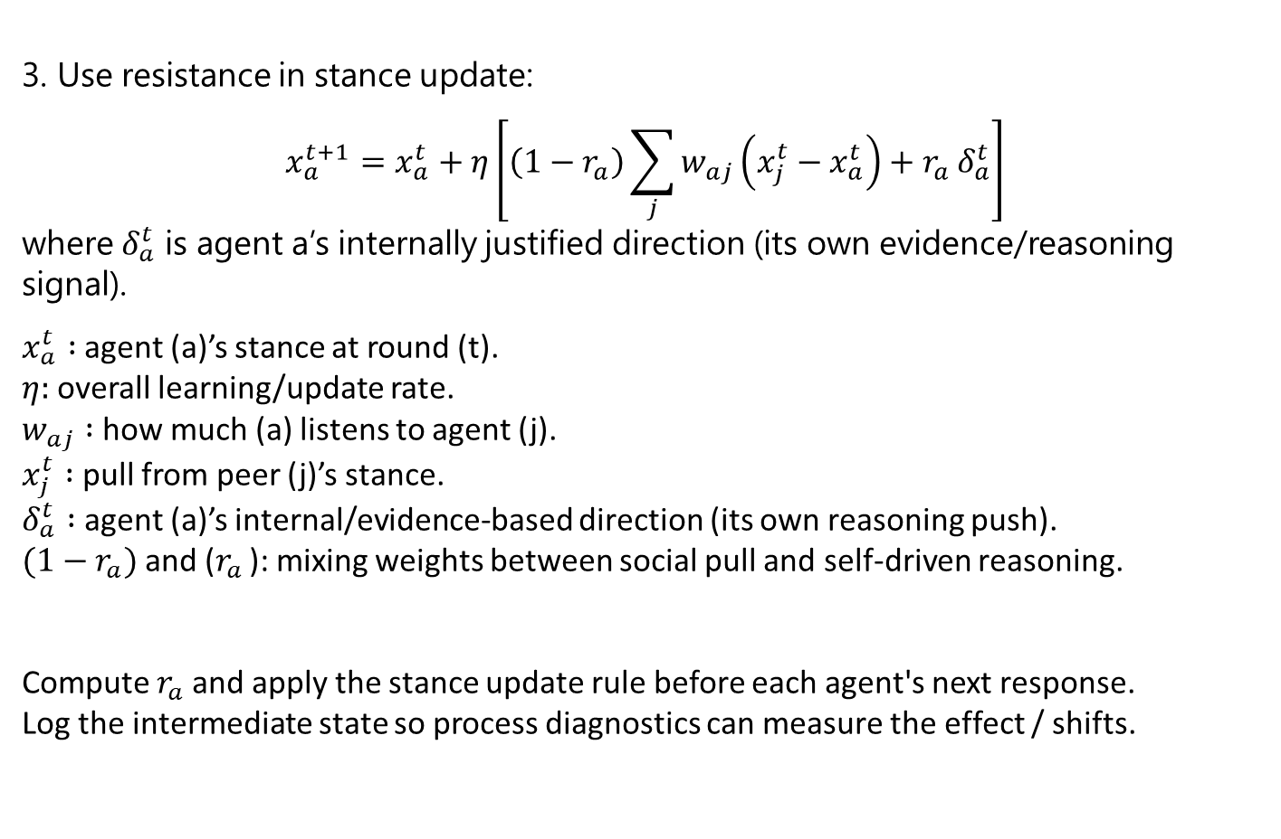
Experiment 2: Loser-More-Resistance
3. Use resistance in stance update:
$$x_{a}^{t+1}=x_{a}^{t}+η\left[\left(1−r_{a}\right)\sum_{j}{w_{aj}}\left(x_{j}^{t}−x_{a}^{t}\right)+r_{a} δ_{a}^{t}\right]$$
where $δ_{a}^{t}$ is agent a’s internally justified direction (its own evidence/reasoning signal).
$x_{a}^{t} :$agent (a)’s stance at round (t).
$η:$overall learning/update rate.
$w_{aj} :$how much (a) listens to agent (j).
$x_{j}^{t} :$pull from peer (j)’s stance.
$δ_{a}^{t} :$agent (a)’s internal/evidence-based direction (its own reasoning push).
$(1−r_{a})$and ($r_{a}$): mixing weights between social pull and self-driven reasoning.
Compute $r_{a}$and apply the stance update rule before each agent's next response.
Log the intermediate state so process diagnostics can measure the effect / shifts.

Slide 39

Experiment 3: Minority Protection
1. Define Minority & Majority
$$\text{Majority}\left(t\right)=\arg{\underset{ans}{\max{}}}∣\left\{a∈A:x_{a}^{t}=ans\right\}∣$$
$$\text{Minority}\left(t\right)=\left\{a∈A:x_{a}^{t}≠\text{Majority}\left(t\right)\right\}$$
$$I_{a}^{min}\left(t\right)=\left\{\begin{matrix}1 & \text{if} a∈\text{Minority}\left(t\right) \\ 0 & \text{otherwise}\end{matrix}\right.$$

